Slide 1
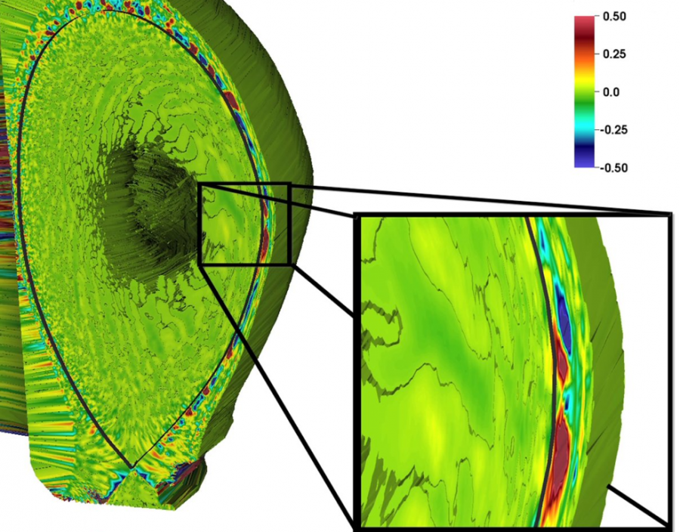
Remote Fusion Experiment Data Analysis Through Wide-Area Network
Abstract:
We demonstrate remote data processing capability of large and high-throughput science experiment through cross-Pacific wide area networks and show how we can manage science workflow executions remotely by using ORNL ADIOS data management system and FNAL mdtmFTP data transfer system.
In this demo, we show a fusion data processing workflow, called Gas Puff Imaging (GPI) analysis, to detect and trace blob movements during fusion experiment. We send GPI data streams from Singapore to Fermilab for near-real time analysis. ADIOS manages analysis workflows and mdtmFTP transports stream data.
Blobs in fusion reaction (EPSI project)
Blob
trajectory

Slide 2
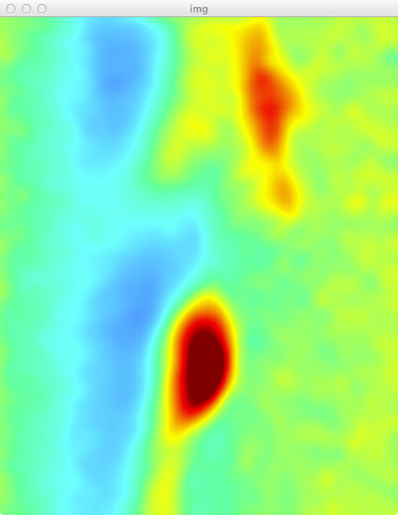
SC16: NSTX GPI Workflow With ADIOS and MDTM
Resolution: 640x512
1.25 MB per image
400K frames per second
500 GB per second
Raw
Images
De-noising
Indexing
Chunk-based Reduciton
ZFP
Compress
Adios
Singapore
MDTM
USA
Adios
ZFP
Decomp.
Chunk Assemble
Segmentation
Blob Detection
Blob Tracking
Blob Prediction

Slide 3
ZFP Compression (floating-point data compression)
Fixed-rate floating point data compression
Lossy
Fast and efficient
Block-based transform
Bit plane wise compression
Original
Rate=4/32
Rate=1/32

